Slide 1
More classification algorithms: k-NN, SVMs, Ensemble Textbook chapters 2.4, 5.2, 5.5-5.7
IST565 Data Mining

Slide 2
Review distance measure

Slide 3
Classification Process

Slide 4
Machine Learning algorithms
Algorithms like decision tree and naïve Bayes will construct a learning model from training examples, and then apply the model for prediction on new test examples.
Refund
Yes
No
NO
MarSt
Single, Divorced
Married
TaxInc
NO
< 80K
> 80K
NO
YES

Slide 5

Instance-based learning
In contrast, instance-based learning methods simply store the training examples without doing any calculations during training process, and classification/prediction is delayed until new examples are given.
Lazy learner
All calculations happen during prediction

Slide 6
K-Nearest Neighbor (k-NN)
Training process:
Read in all training examples
Classification process:
Given a test example, compare the similarity between the test example and all training examples, choose the majority-voted category label in the k nearest training examples

Slide 7
Nearest Neighbor Classification…
Choosing the value of k:
If k is too small, sensitive to noise points
If k is too large, neighborhood may include points from other classes

Slide 8
Advantages of kNN
No assumptions made
Remember the independence assumption in naïve Bayes
Works well when the decision function to be learned is very complex
Notes:
The kNN algorithm is surprisingly simple, how is its performance in real use? Actually it works very well on many tasks.
Why does the shape of decision boundary matter

Slide 9
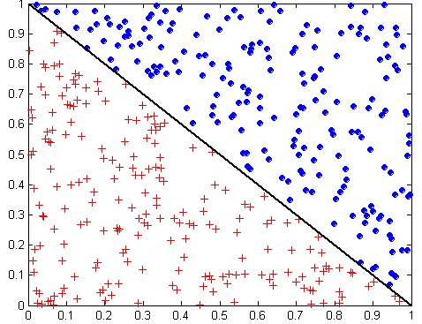
The shape of decision boundary matters
Notes:
Computational learning theory concept: decision boundary

Slide 10
Decision boundary of decision tree models
Notes:
The model fits the data perfectly

Slide 11
Decision boundary of linear models
Linear: naïve Bayes, SVM
How many parameters to determine a line in 2D space?
Y=ax+b
Weight
intercept

Slide 12
Why is NB a linear classifier?
The decision function can be re-written to a linear function
Original decision function
Prob(Ci)*Prob(T1|Ci)*Prob(T2|Ci) * ... *Prob(Tm|Ci))
Apply log transformation
log(Prob(Ci)) + log(Prob(T1|Ci)) + log(Prob(T2|Ci)) + ... + log(Prob(Tm|Ci))
http://cs.nyu.edu/faculty/davise/ai/bayesText.html

Slide 13
The shape of decision boundary matters
Decision tree model fits;
not the linear model
Linear model fits;
not decision tree model
Notes:
Computational learning theory Left side, not linearly separable

Slide 14
Advantage of kNN
The decision boundary has no pre-defined shape

Slide 15
Disadvantages of kNN (1)
Sensitive to noisy training data
All attributes participate in classification
If only a few relevant attributes are relevant to prediction, the participation of those irrelevant attributes would harm the prediction performance.

Slide 16
Disadvantage of kNN (2)
High computational cost.
Pre-computed models can be quickly applied to test data
Since there is no training step, nearly all computation takes place in the prediction step.
Notes:
Algorithms like naïve Bayes would create a model on the training data, and then use the model only to predict new data, which is fast.

Slide 17
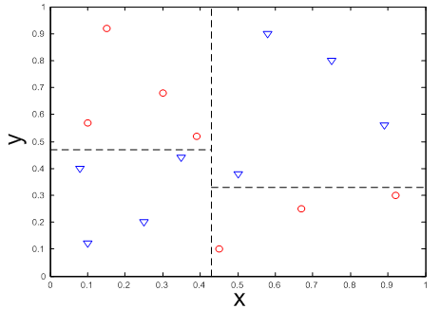
The shape of decision boundary
Some data are not linearly separable
Support Vector Machines (SVMs): an algorithm that can solve both linearly separable and inseparable problems
Notes:
Left side problem, even DT can’t fit

Slide 18
Support Vector Machines
Find a linear hyperplane (decision boundary) that can separate the data
Notes:
In 2d space, it’s a line, 3d space a plane, higher-d space hyperplane

Slide 19
Support Vector Machines
One Possible Solution
Notes:
Decide unknown instance by which side of the line they fall on

Slide 20
Support Vector Machines
Another possible solution

Slide 21
Support Vector Machines
Numerous possible solutions

Slide 22
Support Vector Machines
Which one is better? B1 or B2?
How do you define better? (e.g. least square fitting)

Slide 23
Support Vector Machines
Find a hyperplane that maximizes the margin => B1 is better than B2
Notes:
Vapnik inventor
Margin is a stripe-shaped area that separates the two classes. In the graph, B1 and B2 are two different margins.

Slide 24
Support Vector Machines
Support vectors
Notes:
What is it called SVM

Slide 25
Support vectors
Support vectors are the training examples (“vectors”) that are located on the margins
Support vectors

Slide 26
Decision boundary
Only support vectors determine the decision boundary.
Support vectors

Slide 27
Non-support vectors
Training examples which are not support vectors do not participate in prediction
Non-support vectors

Slide 28
Model complexity
The number of support vectors is an indicator of the complexity of the trained SVM model
Support vectors

Slide 29
Prediction confidence
The distance between the example and the decision boundary is an indicator of prediction confidence: the farther the better
Support vectors
Higher confidence
lower confidence

Slide 30
Prediction confidence
SVMs Prediction result can be sorted by confidence, and thus is suitable for semi-supervised learning and active learning
Variant SVMs algorithm can be used for regression

Slide 31
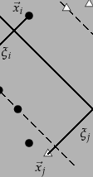
Soft-margin SVMs
No perfect linear boundary can be found between the two classes due to outliers
Introduce a slack variable ξ to pay a cost for each misclassified example
Figure 15.5 from http://nlp.stanford.edu/IR-book/html/htmledition/soft-margin-classification-1.html
Notes:
Noise in the data

Slide 32
Regularization in C-SVC
Tune the regularization parameter C (cost for misclassification)
Default value C=1
When C is large (high cost), the algorithm tries to build model with fewest training errors, resulting in narrow margin and high chance of overfitting
When C is small (low cost), wider margin, more robust
However, C cannot be too small, or else it does not respect the data at all.
Notes:
C-SVC is a popular kind of SVM

Slide 33
Regularization
Use manual tuning or gradient descent search to find the best C
E.g. set C’s search range from 0.1 to 1.0 and increase with step size 0.05.
error
C=1
C=0.1

Slide 34
A visualization from Coursera
https://class.coursera.org/ml-003/lecture/72
07:13-9:00

Slide 35
The Kernel trick in SVM
Some data are not linearly separable
But they are linearly separable in higher-dimensional space
Map the data to higher dimensional space, so that inseparable problems become separable
Notes:
http://www.youtube.com/watch?v=3liCbRZPrZA

Slide 36
Kernel functions
SVM algorithm maximizes the margin between the two separating hyperplanes by finding the maximum of the functional
Subject to the constraints

Slide 37
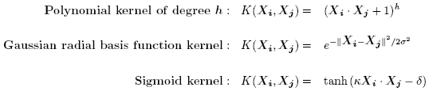
SVM—Kernel functions
Linear kernel: K(X_{i}, X_{j}) =X_{i} ∙ X_{j} (cosine similarity)
Higher rank kernels: instead of computing on the transformed data tuples, it is mathematically equivalent to instead applying a kernel function K(X_{i}, X_{j}) to the original data, i.e., K(X_{i}, X_{j}) = Φ(X_{i}) Φ(X_{j})
Typical Kernel Functions

Slide 38
Extend binary classification to multi-class
Given n classes, e.g.
Sentiment = {positive, negative, neutral, no opinion}
One-vs-one (pairwise) strategy:
Create n(n-1)/2 classifiers: pos|neg, pos|neu, pos|np, neg|neu, neg|np, neu|np
Pick the most confident prediction
One-vs-all strategy:
Create n classifiers: positive or not, negative or not, neutral or not, np or not
Pick the most confident prediction

Slide 39
SVMs Strength
High tolerance to noisy data
Flexibility in data representation: well-suited for continuous- or discrete-valued inputs and outputs
Probabilistic prediction result
Scalability: successful on extremely large problems
Successful on a wide array of real-world data
Notes:
Probabilistic result: sigmoid function

Slide 40
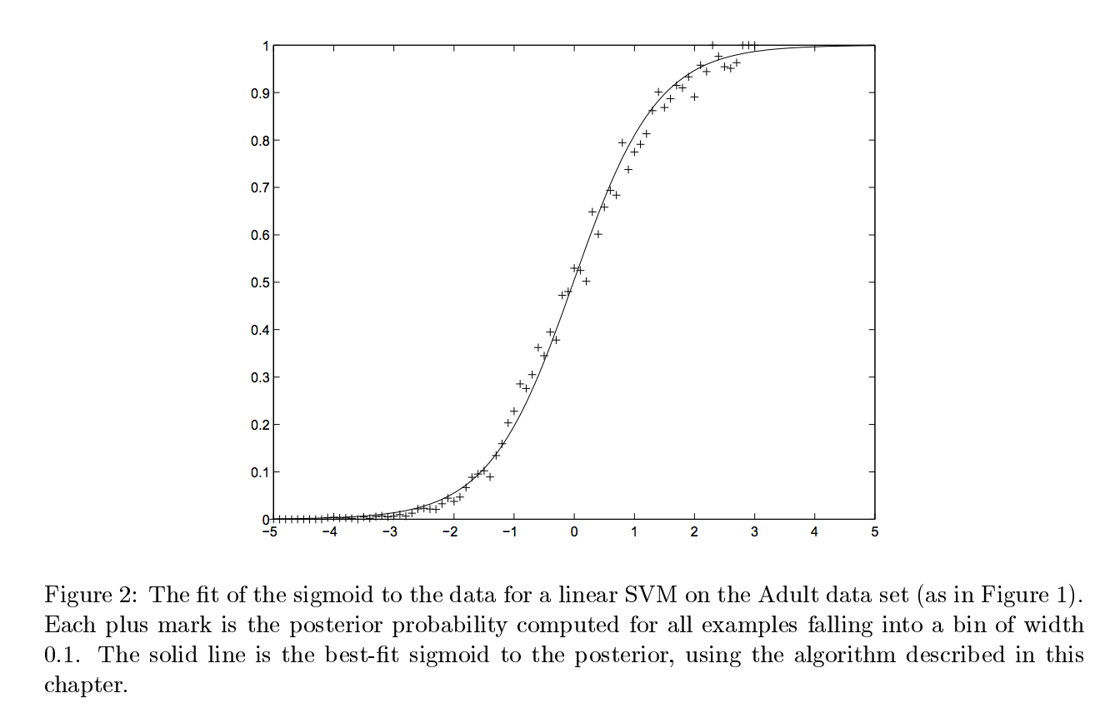
Probabilistic output of SVMs
Platt, J. (1999). Probabilistic outputs for support vector machines and comparisons to regularized likelihood methods. Advances in large margin classifiers, 10(3), 61-74.

Slide 41
SVMs weakness
Require a number of parameters for each kernel type
Interpretability
Easy interpretation for linear kernel
Difficult to interpret the model generated by nonlinear kernels

Slide 42
Ensemble Methods
Construct a set of classifiers from the training data
Predict class label of previously unseen records by aggregating predictions made by multiple classifiers

Slide 43
General Idea

Slide 44
Why does ensemble work?
Suppose there are 25 base classifiers
Each classifier has error rate, ε = 0.35 (weak learner)
Assume classifiers are independent
Use majority voting to combine results, so ensemble makes a wrong prediction only if over half of the base classifiers are wrong
Probability that the ensemble classifier makes a wrong prediction:
Error rate is reduced from .35 to .06
In practice, the base classifiers may not be totally independent for a reduction in error rate to occur
Notes:
It’s like patients might ask multiple doctors to get a reliable diagnosis.
Make sure the classifiers are not correlated, like all doctors consulted came from same training experience.
Every classifier may capture different aspects of the same data set.

Slide 45
Bagging
Sampling with replacement
Build classifier on each bootstrap sample
Each sample has probability (1 – 1/n)^{n} of being selected

Slide 46
Boosting
An iterative procedure to adaptively change distribution of training data by focusing more on previously misclassified records
Initially, all N records are assigned equal weights
Unlike bagging, weights may change at the end of boosting round

Slide 47
Boosting
Records that are wrongly classified will have their weights increased
Records that are classified correctly will have their weights decreased
Example 4 is hard to classify
Its weight is increased, therefore it is more likely to be chosen again in subsequent rounds

Slide 48
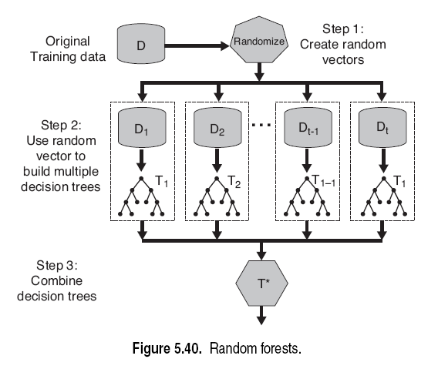
Random Forest
Randomly select subset of features
Model with too many trees tends to overfit
Notes:
Randomly select a subset of features to reduce correlation among trees.

Slide 49
Exercise: kNN
In Weka the kNN algorithm is located at “lazy->ibk”. Report accuracy when k=1,3,5,7. Pick the best k value and then change the weighted distance strategy. Report if distance weighting helps or not.

Slide 50
Exercise: SVMs
In weka the SVM algorithm is located at “functions->SMO”. Report and compare accuracies of the default kernel and RBF kernel. After picking the better kernel, tune C=1, 0.8, 0.5, 0.3, 0.1 Report accuracies and summarize if C tuning helps or not.

Slide 51
Exercise: random forest
Tune the number of trees = 5, 10, 25, 50, 100. Which random forest is more likely to overfit?

Slide 52
Exercise: algorithm comparison
Compare algorithm performance on Titanic task. Which algorithm is the best? Why?
Same data preprocessing and 5-fold CV

